Slide 1
Survival Analysis (Time-to-Event Analysis)
Notes:
I’m not going to attempt to teach you everything there is to know about survival analysis. When I was in grad school, we took an entire course on survival analysis. But, I am going to give you a brief introduction to survival analysis. My hope is that by the end of this lecture you will have an intuitive understanding about what survival analysis is, why it exists, and under what circumstances you may want to look into using it in the future.

Slide 2
Acute lymphoblastic leukemia (ALL)
﻿A study of 6-mercaptopurine (6-MP) as maintenance therapy for children in remission from acute lymphoblastic leukemia (ALL) (Freireich et al. 1963).
﻿Forty-two patients achieved remission from induction therapy and were then randomized in equal numbers to 6-MP or placebo. The survival time studied was from randomization until relapse. At the time of the analysis, all 21 patients in the placebo group had relapsed, whereas only 9 of 21 patients in the 6-MP group had relapsed.
Source: Vittinghoff, Eric, Glidden, David V., Shiboski, Stephen C., McCulloch, Charles E.. Regression Methods in Biostatistics: Linear, Logistic, Survival, and Repeated Measures Models: 0 (Statistics for Biology and Health) (p. 54). Springer New York.
Notes:
Let’s start exploring survival analysis by way of example. This on comes from the Regression Methods in Biostatistics textbook you see cited on the bottom of the slide. The. data comes from a study of 6-mercaptopurine (6-MP) as maintenance therapy for children in remission from acute lymphoblastic leukemia (ALL).
In this study, forty-two patients achieved remission from induction therapy and were then randomized in equal numbers to 6-MP or placebo. The survival time studied was from randomization until relapse. At the time of the analysis, all 21 patients in the placebo group had relapsed, whereas only 9 of 21 patients in the 6-MP group had relapsed. So, it sounds like 6-MP may be effective at preventing, or at least postponing ALL relapse.
I’ve underlined “from randomization until relapse” here because it highlights two key characteristics of survival analysis. While not completely obvious from the sentence on the slide, not all children enrolled in this study were enrolled at the same time. We can’t assign 42 children to achieve remission on the same day so that we can conveniently randomize them to a treatment and observe what happens to them for some predefined amount of time. If we could, then we would have a closed, or at least fixed, cohort and we would have the ability to calculate the cumulative incidence as we’ve done in the past.
The second component of survival analysis that this sentence highlights is that the event of interest does not have to be death (or survival). We can use survival analysis to analyze the time to any outcome. In this example, we’re interested in the time to cancer relapse. For this reason, survival analysis is sometimes called by a more generic name – time-to-event analysis. I actually prefer that name.
I’ve also underlined “at the time of analysis” here because it highlights another key components of survival analysis. That is, our data doesn’t contain information about whether or not each child ever relapsed. We only have information about each child up to a certain point in time. For example, one child was only under observation for six weeks at the time of the analysis, so we only know that the relapse time was longer than that. Such a survival time is said to be right-censored, “right” because on a graph the relapse time would lie somewhere to the right of the censoring time of six weeks.

Slide 3
Survival Analysis
Can accommodate different participant start times.
Can accommodate different amounts of participant follow-up time.
Allows us to analyze time to events, rather than occurrence (yes/no) of events only.
Can accommodate censoring.
Right-censoring: A survival time is said to be right-censored at time t if it is only known to be greater than t.
Notes:
Already, we’ve seen some features of survival analysis that may be worth summarizing.

Slide 4
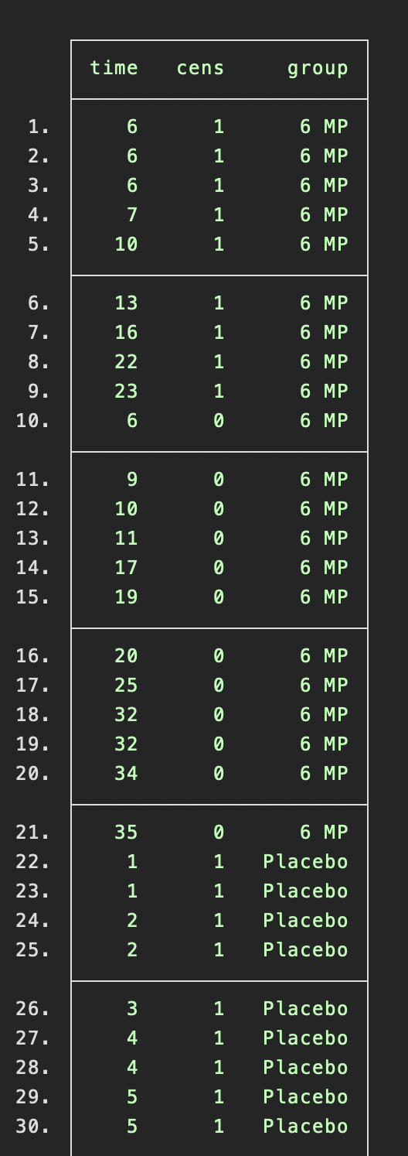
Source: Vittinghoff, Eric, Glidden, David V., Shiboski, Stephen C., McCulloch, Charles E.. Regression Methods in Biostatistics: Linear, Logistic, Survival, and Repeated Measures Models: 0 (Statistics for Biology and Health) (p. 54). Springer New York.
Notes:
Here’s a little glimpse at what the ALL data looks like in Stata.
Time is in weeks.

Slide 5
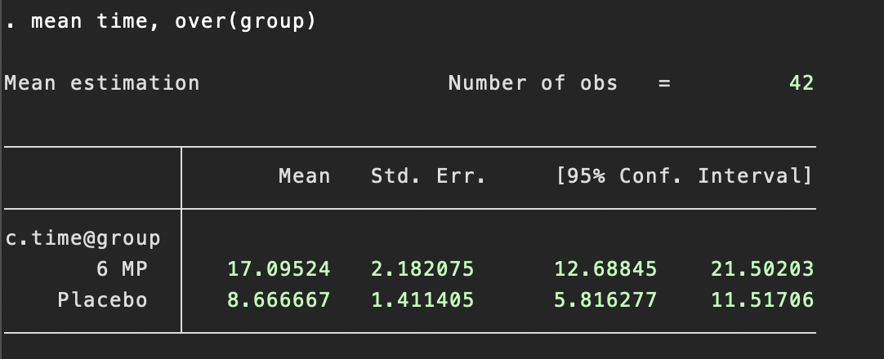
Source: Vittinghoff, Eric, Glidden, David V., Shiboski, Stephen C., McCulloch, Charles E.. Regression Methods in Biostatistics: Linear, Logistic, Survival, and Repeated Measures Models: 0 (Statistics for Biology and Health) (p. 54). Springer New York.
Notes:
So, we’re gathering data on these kids to when their ALL relapses. We want to know if this new treatment, 6-MP, postpones their relapses. On way we could try to answer that questions is simply calculate the mean time to relapse for each child who got 6-MP, the mean time to relapse for each child who did not get 6-MP, and then compare those mean times. In fact, that is the analysis you see on this slide. But, what is the problem with this strategy?
Using this strategy would ignore the right-censoring. It would effectively treat a child who was censored at 6 weeks as though they relapsed at 6 weeks. In reality, the child might not have relapsed for a much longer period of time. Not accounting for censoring may lead us to throw away valuable evidence for the effectiveness of the 6-MP treatment. Survival analysis makes it possible to analyze right-censored data like these without bias or losing information contained in the length of the follow-up times.

Slide 6
Week | N Followed | N Relapsed (Event) | N Censored | Cond. Prob. Of Remission | Survival Function¹
1 | 21 | 2 | 0 | 19/21 = 0.90 | 0.90
2 | 19 | 2 | 0 | 17/19 = 0.89 | 0.90 * 0.89 = 0.80
3 | 17 | 1 | 0 | 16/17 = 0.94 | 0.80 * 0.94 = 0.75
4 | 16 | 2 | 0 | 14/16 = 0.88 | 0.75 * 0.88 = 0.66
5 | 14 | 2 | 0 | 12/14 = 0.86 | 0.66 * 0.86 = 0.57
6 | 12 | 0 | 0 | 12/12 = 1.00 | 0.57 * 1.00 = 0.57
7 | 12 | 0 | 0 | 12/12 = 1.00 | 0.57 * 1.00 = 0.57
8 | 12 | 4 | 0 | 8/12 = 0.67 | 0.57 * 0.67 = 0.38
9 | 8 | 0 | 0 | 8/8 = 1.00 | 0.38 * 1.00 = 0.38
10 | 8 | 0 | 0 | 8/8 = 1.00 | 0.38 * 1.00 = 0.38
1. Also called the cumulative probability of survival.
Source: Vittinghoff, Eric, Glidden, David V., Shiboski, Stephen C., McCulloch, Charles E.. Regression Methods in Biostatistics: Linear, Logistic, Survival, and Repeated Measures Models: 0 (Statistics for Biology and Health) (p. 54). Springer New York.
Notes:
Here is a life table for the first 10 weeks of the placebo group only.
Because there is no right-censoring in the placebo group, we could simply estimate the survival function by the sample proportion in remission for each week. For example, we could add the number of relapses 2+2+1+2+2+4 = 13 and subtract that from 21, the number of people initially at risk, to get 8. The number of people who did not experience relapse within 10 weeks of remission. We could then divide that number, 8, by the number of people initially at risk, 21, to get the probability of not experiencing relapse within 10 weeks of remission. 8 divided by 21 is 0.38. That’s the same final result we get using the complicated life-table approach. Again, there is no difference in our results in this case because there is no censoring in this data.

Slide 7
Week | N Followed | N Relapsed (Event) | N Censored | Cond. Prob. Of Remission | Survival Function¹
1 | 21 | 0 | 0 | 21/21 = 1.00 | 1.00
2 | 21 | 0 | 0 | 21/21 = 1.00 | 1.00 * 1.00 = 1.00
3 | 21 | 0 | 0 | 21/21 = 1.00 | 1.00 * 1.00 = 1.00
4 | 21 | 0 | 0 | 21/21 = 1.00 | 1.00 * 1.00 = 1.00
5 | 21 | 0 | 0 | 21/21 = 1.00 | 1.00 * 1.00 = 1.00
6 | 21 | 3 | 1 | 18/21 = 0.86 | 1.00 * 0.86 = 0.86
7 | 17 | 1 | 0 | 16/17 = 0.94 | 0.86 * 0.94 = 0.81
8 | 16 | 0 | 0 | 16/16 = 1.00 | 0.81 * 1.00 = 0.81
9 | 16 | 0 | 0 | 16/16 = 1.00 | 0.81 * 1.00 = 0.81
10 | 16 | 0 | 1 | 16/16 = 1.00 | 0.81 * 1.00 = 0.81
1. Also called the cumulative probability of survival.
Source: Vittinghoff, Eric, Glidden, David V., Shiboski, Stephen C., McCulloch, Charles E.. Regression Methods in Biostatistics: Linear, Logistic, Survival, and Repeated Measures Models: 0 (Statistics for Biology and Health) (p. 54). Springer New York.
Notes:
Now let’s take a look at the data for the children in the 6-MP group. This time there is censoring and simply dividing the number in remission at week 10, 16, by the number of people at risk at the start of follow-up, 21, would result in a survival probability of 0.76 -- an underestimate of the unbiased survival probability you see here – 0.81.
In essence, we have estimated the survival functions in the placebo and 6-MP groups using the well-known Kaplan–Meier estimator to deal with right censoring.

Slide 8
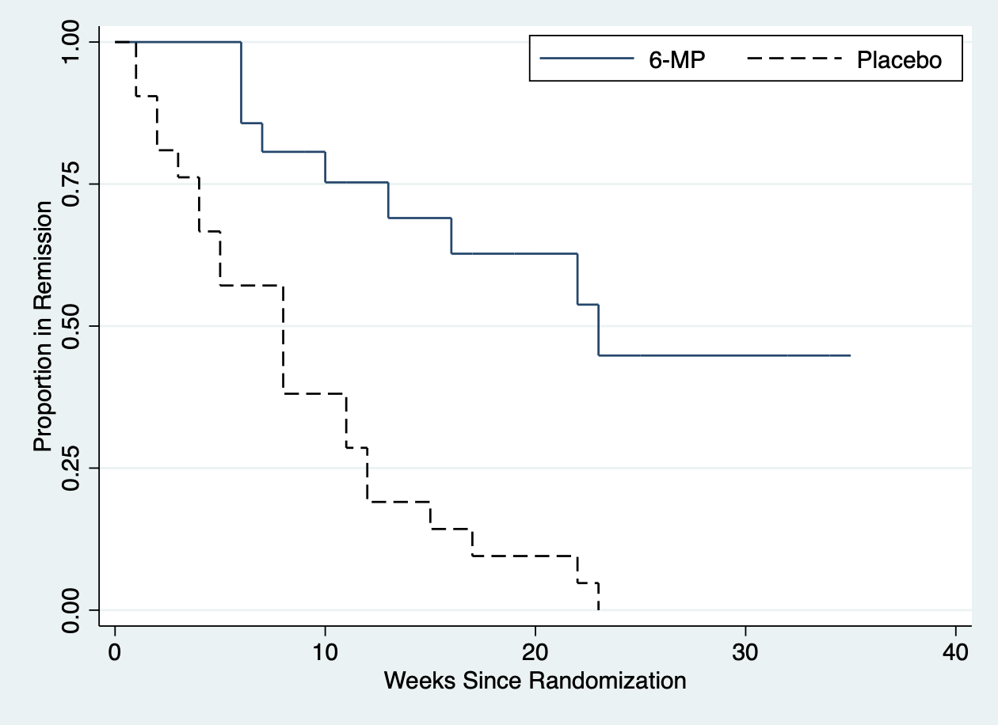
Source: Vittinghoff, Eric, Glidden, David V., Shiboski, Stephen C., McCulloch, Charles E.. Regression Methods in Biostatistics: Linear, Logistic, Survival, and Repeated Measures Models: 0 (Statistics for Biology and Health) (p. 54). Springer New York.
Notes:
We can then plot the Kaplan–Meier estimates of the survival function for the 6-MP and placebo groups like you see here. Note that the curves drop at observed relapse times and are flat in the intervening periods.
The estimated survival function for the 6-MP group is above the placebo curve over the entire follow-up period, giving evidence for higher probability of remaining in remission, or equivalently longer times in remission and lower risk of relapse in patients treated with 6-MP.
Simply viewing and comparing these curves can be very informative. However, there are also some useful statistics we can use to summarize these curves.

Slide 9
8
23
Source: Vittinghoff, Eric, Glidden, David V., Shiboski, Stephen C., McCulloch, Charles E.. Regression Methods in Biostatistics: Linear, Logistic, Survival, and Repeated Measures Models: 0 (Statistics for Biology and Health) (p. 54). Springer New York.
Notes:
﻿For example, we can use the Kaplan–Meier results to estimate the median survival time in each group. The median survival time is defined as the time at which half the relevant population has experienced the event of interest. It is estimated by the earliest time at which the Kaplan–Meier curve dips below 0.50.
In the graph on this slide, we can see that the estimated median time to relapse is 23 weeks for 6-MP group, as compared to 8 weeks for placebo — more evidence for the effectiveness of 6-MP as maintenance therapy for ALL.
In addition to estimating and comparing the median survival times between groups, we can also use the log-rank test to formally test for a difference between the curves.

Slide 10
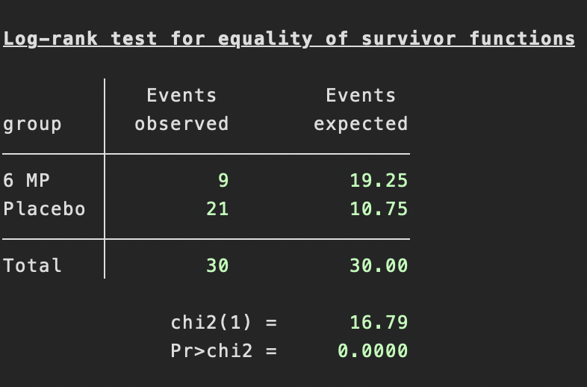
Source: Vittinghoff, Eric, Glidden, David V., Shiboski, Stephen C., McCulloch, Charles E.. Regression Methods in Biostatistics: Linear, Logistic, Survival, and Repeated Measures Models: 0 (Statistics for Biology and Health) (p. 54). Springer New York.
Notes:
Here, you can see what the results of the log-rank test calculated by Stata look like. The null hypothesis for this test is that the survival distributions being compared are equal at all follow-up ﻿times. In the leukemia example, this implies that the population survival curves for 6-MP and placebo overlap each other. The alternative hypothesis is that the two survival curves differ at one or more points in time.
In our example data there are a total of 30 events (relapses), 21 in the placebo group and 9 in the 6-MP group. The column labeled Events expected gives the expected number of events in the two groups under the null hypothesis of equal survival functions. In the leukemia data, average follow-up was considerably shorter in the placebo group and hence fewer events would be expected in that group. Clearly there were many more events than expected among placebo participants, and many fewer than expected in the 6-MP group. The resulting χ 2 statistic of 16.8 is statistically significant ( P < 0. 00005), in accord with our earlier impression that 6-MP is effective maintenance therapy for patients with ALL.
I think the Kaplan-Meier life tables, curves, and log-rank tests are a pretty intuitive method for analyzing time-to-event data. However, as our data and analyses become more complex we will start to notice limitations in these methods. For example, what if we want to account for – or control for – important confounding factors in our time-to-event analysis. Typically, in modern epidemiology we would do so with the help of regression models.

Slide 11
Proportional Hazards Regression
Linear regression results in biased comparisons of time to events because of right-censoring.
Logistic regression isn’t ideal because of variable lengths of follow-up.
Source: Vittinghoff, Eric, Glidden, David V., Shiboski, Stephen C., McCulloch, Charles E.. Regression Methods in Biostatistics: Linear, Logistic, Survival, and Repeated Measures Models: 0 (Statistics for Biology and Health) (p. 54). Springer New York.
Notes:
I think all of you should have been exposed to linear and logistic regression already. Those of you who have may be tempted to use linear regression to model and compare the times to events. However, right-censoring will lead us to biased estimates if we use this method. Using linear regression in this case would be the regression equivalent the comparison of mean survival times we saw at the beginning of this presentation.
You might also be tempted to use logistic regression to estimate and compare the odds of event occurrence between groups. Unfortunately, this method doesn’t work well either. Primarily because the participants have differing lengths of follow-up. In other words, that method would treat a participant who provided information to our study for one day that same as a participant who provided information to our study for 10-years.
Let’s take a look at another example, and see how we can use proportional hazards regression to overcome these limitations.

Slide 12
Days Since transplant | N Followed | N Died (Event) | N Censored | Cond. Prob. Of Death per 1,000 Subject-Days (Death Rate)
1 | 9,750 | 7 | 14 | 7 / 9,750 * 1,000 = 0.72
2 | 9,729 | 5 | 8 | 5 / 9,729 * 1,000 = 0.51
3 | 9,716 | 5 | 12 | 5 / 9,716 * 1,000 = 0.51
4 | 9,699 | 7 | 41 | 7 / 9,699 * 1,000 = 0.72
5 | 9,651 | 3 | 54 | 3 / 9,651 * 1,000 = 0.31
6 | 9,594 | 2 | 57 | 2 / 9,594 * 1,000 = 0.21
7 | 9,535 | 0 | 50 | 0 / 9,535 * 1,000 = 0.00
8 | 9,485 | 4 | 49 | 4 / 9,485 * 1,000 = 0.42
9 | 9,432 | 1 | 49 | 1 / 9,432 * 1,000 = 0.11
10 | 9,382 | 3 | 28 | 3 / 9,382 * 1,000 = 0.32
Source: Vittinghoff, Eric, Glidden, David V., Shiboski, Stephen C., McCulloch, Charles E.. Regression Methods in Biostatistics: Linear, Logistic, Survival, and Repeated Measures Models: 0 (Statistics for Biology and Health) (p. 54). Springer New York.
Notes:
To get a feel for how proportional hazards regression works, we need to start by getting a feel for what the hazard function is.
We’ve already seen the survival function. Again, the survival function represents the probability of being event free at a given point in time.
The hazard function is the short-term event rate for participants who have not yet experienced the event of interest. For example, this table shows mortality rates for children who have recently undergone kidney transplantation, on each of the first ten days after surgery, using data from the united network for organ sharing (UNOS). At the beginning of fifth day after surgery, for example, 9,651 children remained alive and in the study, and of these, 3 died during the next 24 hours. This results in an estimated death rate of 0.31 deaths per 1,000 subjects per day conditional on surviving to the 5th day. Collectively, these conditional probabilities of event make up the hazard function.

Slide 13
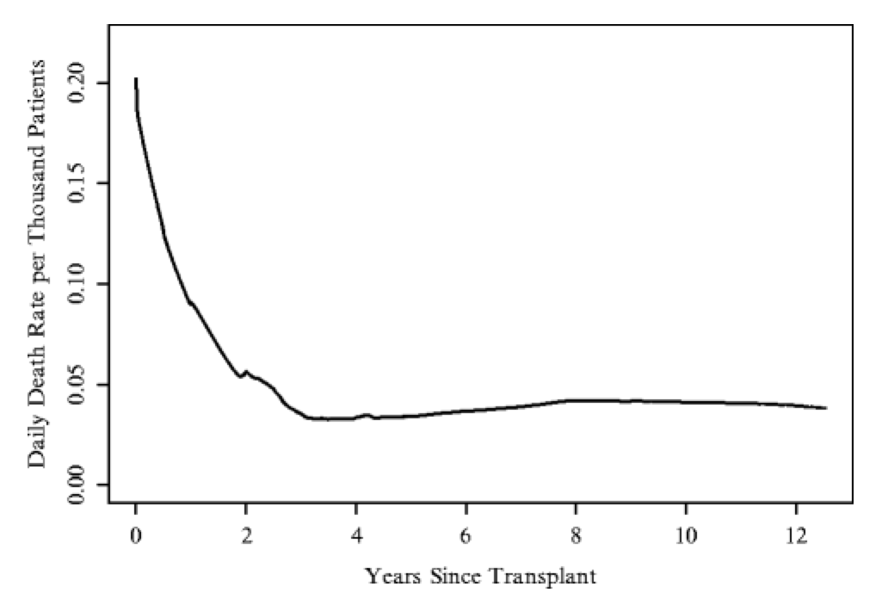
Source: Vittinghoff, Eric, Glidden, David V., Shiboski, Stephen C., McCulloch, Charles E.. Regression Methods in Biostatistics: Linear, Logistic, Survival, and Repeated Measures Models: 0 (Statistics for Biology and Health) (p. 54). Springer New York.
Notes:
﻿This graph shows the daily death rates, smoothed by procedure called LOWESS, for a much longer time period, the first 12 years after transplantation. As you can see the mortality hazard starts out relatively high and then declines rapidly over the course of the first 2 years, reaching a plateau approximately 3 years after transplantation.

Slide 14
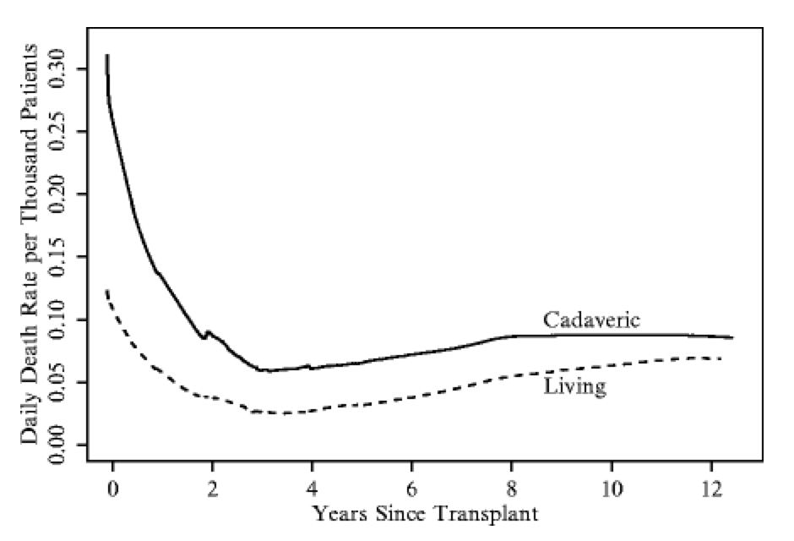
Source: Vittinghoff, Eric, Glidden, David V., Shiboski, Stephen C., McCulloch, Charles E.. Regression Methods in Biostatistics: Linear, Logistic, Survival, and Repeated Measures Models: 0 (Statistics for Biology and Health) (p. 54). Springer New York.
Notes:
We can also compare the hazard functions for two or more groups. In this graph, we are comparing the hazard functions for ﻿for children whose transplanted kidney was provided by a living donor, commonly a family member, and ﻿those for whom the source was recently deceased – called cadaveric. The mortality rate is considerably lower among the recipients of kidneys from living donors at all time points, but the curves are similar in shape.

Slide 15
Years Since Transplant | Smoothed Cadaveric Death Rate (per 1,000) | Smoothed Living Death Rate (per 1,000) | Death Rate Ratio
0.25 | 0.235 | 0.098 | 2.40
0.50 | 0.193 | 0.082 | 2.36
1.00 | 0.138 | 0.061 | 2.27
2.00 | 0.088 | 0.038 | 2.30
3.00 | 0.061 | 0.027 | 2.25
4.00 | 0.063 | 0.026 | 2.37
5.00 | 0.065 | 0.032 | 2.03
Source: Vittinghoff, Eric, Glidden, David V., Shiboski, Stephen C., McCulloch, Charles E.. Regression Methods in Biostatistics: Linear, Logistic, Survival, and Repeated Measures Models: 0 (Statistics for Biology and Health) (p. 54). Springer New York.
Notes:
This table shows the values of a portion of the LOWESS-smoothed death rates we saw in the previous graph. In the far right column, it also contains the death rate ratio.
﻿The results in this table show that while the mortality hazards decline over time in both groups of pediatric kidney transplant recipients, the hazard ratio is roughly constant. In other words, the hazard in the comparison group is a constant proportion of the hazard in the reference group.
This is a key assumption of proportional hazards regression. Under the proportional hazards assumption, the hazard ratio does not vary with time. Provided the hazards are proportional in this sense, the effect of donor source on post-transplant mortality risk can be summarized by a single number.

Slide 16
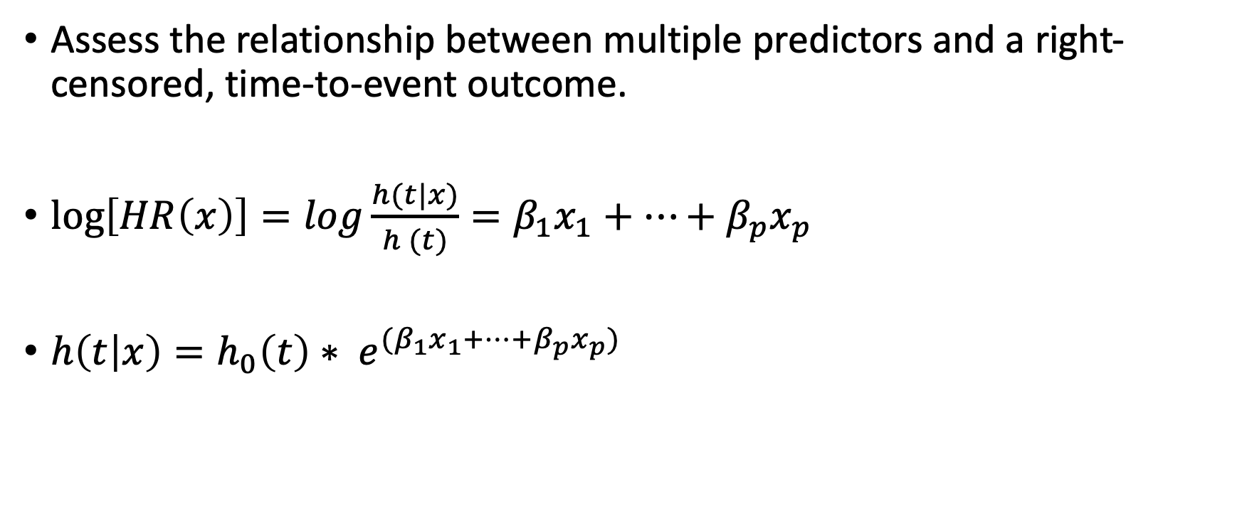
Cox Proportional Hazards Model
Assess the relationship between multiple predictors and a right-censored, time-to-event outcome.
$\log\left[HR\left(x\right)\right]=log\frac{h(t|x)}{h (t)}=β_{1}x_{1}+…+β_{p}x_{p}$
$h\left(t | x\right)=h_{0}\left(t\right)∗ e^{(β_{1}x_{1}+…+β_{p}x_{p})}$
Source: Vittinghoff, Eric, Glidden, David V., Shiboski, Stephen C., McCulloch, Charles E.. Regression Methods in Biostatistics: Linear, Logistic, Survival, and Repeated Measures Models: 0 (Statistics for Biology and Health) (p. 54). Springer New York.
Notes:
﻿The Cox proportional hazards regression model is a flexible tool for assessing the relationship of multiple predictors to a right-censored, time-to-event outcome, and has quite a bit in common with linear and logistic regression models.
I know how scary equations can be for some people. If you’re one of those people, just close your eyes for one slide.
In proportional hazards regression models, the linear predictor is linked through the log-transformation to the hazard ratio. If the hazard ratio obeys the proportional hazards assumption, and thus does not depend on time, we can write it as the first equation you see on this slide. In that equation, the h(t| x ) is the hazard at time t for an observation with covariate value x , and h0(t) is the baseline hazard function. That is the hazard at time t for observations with all predictors equal to zero.
The first equation can also be rewritten as the second equation you see here. Note that exponentiating the linear predictor ensures that HR( x ) cannot be negative, as required. Furthermore, taking the log of both sides of of the equation, shows that the log baseline hazard plays the role of the intercept in other regression models, though in this case it can change over time.

Slide 17
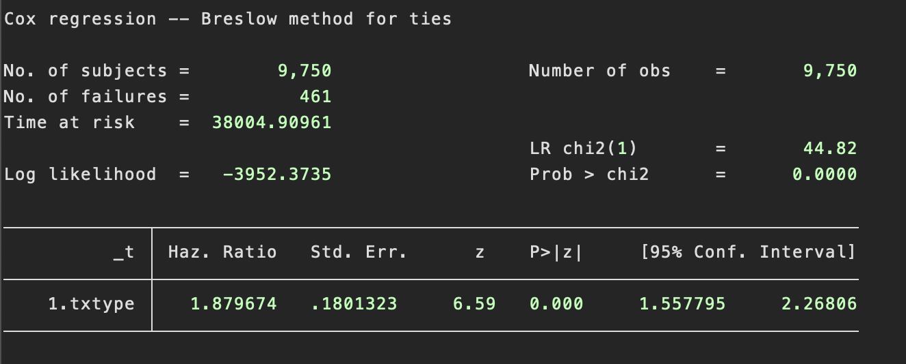
Source: Vittinghoff, Eric, Glidden, David V., Shiboski, Stephen C., McCulloch, Charles E.. Regression Methods in Biostatistics: Linear, Logistic, Survival, and Repeated Measures Models: 0 (Statistics for Biology and Health) (p. 54). Springer New York.
Notes:
If you find the equations from the last slide helpful, that’s great! If not, the good news is that statistical programs, in this case Stata, can do all the math for you.
On the slide, you can see the result of modeling the kidney transplant data we’ve been looking at. The graph and table with the death rate ratio we previously saw showed that the two mortality hazards for pediatric recipients of kidney transplants from living and recently deceased donors were very nearly proportional over time. So, the Cox model appears appropriate for these data, because the proportional hazards assumption appears to be met for this important predictor.
The Stata output here shows the unadjusted Cox model hazard ratio estimate for txtype, a binary indicator identifying the group receiving transplants from recently deceased donors. The estimated hazard ratio of 1.9 (95% CI 1.6–2.3 P < 0. 0005) is consistent with the the death rate ratios we previously saw and suggests that receiving a transplant from a recently deceased donor roughly doubles the mortality risk at every point over the 12 years of follow-up.

Slide 18
Source: Vittinghoff, Eric, Glidden, David V., Shiboski, Stephen C., McCulloch, Charles E.. Regression Methods in Biostatistics: Linear, Logistic, Survival, and Repeated Measures Models: 0 (Statistics for Biology and Health) (p. 54). Springer New York.
Notes:
Again, the 1.9 in the previous output is summarizing the ratio of values that make up these two lines.

Slide 19
DPCA Study of Primary Biliary Cirrhosis
A cohort of 312 participants in a placebo-controlled clinical trial of D-penicillamine (DPCA) for primary biliary cirrhosis (PBC)
PBC destroys bile ducts in the liver, causing bile to accumulate. Tissue damage is progressive and ultimately leads to liver failure.
Time from diagnosis to end-stage liver disease ranges from a few months to 20 years.
During the approximate 10-year follow-up period, 125 study participants died.
Source: Vittinghoff, Eric, Glidden, David V., Shiboski, Stephen C., McCulloch, Charles E.. Regression Methods in Biostatistics: Linear, Logistic, Survival, and Repeated Measures Models: 0 (Statistics for Biology and Health) (p. 54). Springer New York.
Notes:
Let's take a look at another example the help us learn to interpret results from a Cox model.
The investigators also collected data on serum bilirubin levels because they wanted to control for this confounding variable in their regression analysis.

Slide 20
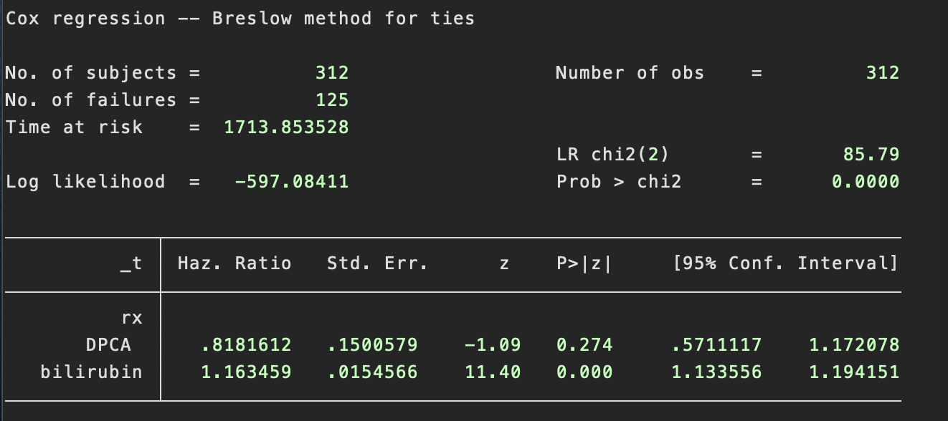
Source: Vittinghoff, Eric, Glidden, David V., Shiboski, Stephen C., McCulloch, Charles E.. Regression Methods in Biostatistics: Linear, Logistic, Survival, and Repeated Measures Models: 0 (Statistics for Biology and Health) (p. 54). Springer New York.
Notes:
Here, we can see the Stata output related to this analysis.﻿
The hazard ratio for treatment, 0.82, means that the estimated short-term mortality risk (or hazard) among patients assigned to DPCA was 82% of the risk in the placebo group. This ratio is assumed to be constant over the 10 years of follow-up. Likewise, the hazard ratio for bilirubin levels means that for each mg/dL increase in bilirubin, short-term hazard is increased by a factor of 1.16.
More generally, in a model with multiple predictors each coefficient can be interpreted as the increase in the hazard ratio for a one-unit increase in the predictor, holding the values of the other predictors constant.
Furthermore, for predictors with ﻿hazard ratios less than 1, increasing values of the predictors are associated with lower risk and longer survival times. Conversely, when hazard ratios are greater than 1 (β > 0), increasing values of the predictor are associated with increased risk and shorter survival times. In using the term risk in this context, it is important to keep in mind the definition of the hazard as a short-term rate and distinguish risk in this sense from cumulative risk over a defined follow-up period.

